Slide 1
Data Structures
Lecture 1
Linear Array Basics and Operations
Prantik Paul [PNP]
Lecturer
Department of Computer Science and Engineering
BRAC University

Slide 2
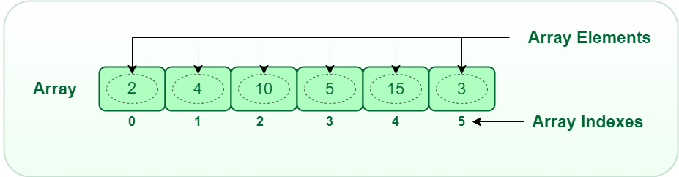
Array - Basics

Slide 3
Array - Basics
Dimension - fixed ( 1, 2, 3, …, 100, ..)
Index
→ 0 - indexing
→ 1 - indexing
Size / Length
Type - Fixed

Slide 4
Array - Basics
Dimension - fixed ( 1, 2, 3, …, 100, ..)
Linear Arrays - 1D
Matrix - 2D
Tensor - 3D

Slide 5
Array - Basics
Index
→ 0 - indexing
→ 1 - indexing
Why 0-indexing?
For efficient memory access

Slide 6
Array - Basics
Size / Length
Size?
Number of Valid Elements
Length?
Fixed - As Declared

Slide 7
Array - Basics
Type - Fixed
Why Not?
Efficient Memory Access

Slide 8
Array - Basics
Integer : 4bytes
Floats : 8bytes
Character : 1byte
Formula-
Starting address of array + index*bytes required for one data

Slide 9
Array - Determine Length
Efficient-
→ Doesn’t store size
→ May give invalid data if index out of bounds
→ can access faster
→ C Fortran

Slide 10
Array - Determine Length
Inefficient-
→ Store size in first byte
→ Check if index out of bound
→ Slow access
→ Java C#

Slide 11
Refresh your memory
for i in range (stop)
for i in range (start, stop)
for i in range (start, stop, step)
Negative step?
Negative stop?

Slide 12
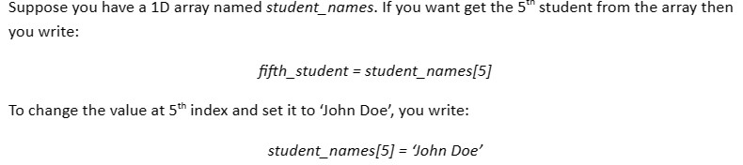
Array - Accessing/Changing an Element

Slide 13
Array - Initializing
array = [None] * length

Slide 14
Array - Initializing
Import numpy as np
my_array = np.array([8, 3, 13, 1])

Slide 15
Array - Initializing
Import numpy as np
my_list = [2, 45, 3, 2, 56]
my_array = np.asarray(my_list)

Slide 16
Array - Initializing
Import numpy as np
size = 5
my_array = np.zeros(size)

Slide 17
Array - Initializing
Import numpy as np
size = 5
my_array = np.ones(size)

Slide 18
Array - Initializing
Import numpy as np
size = 5
my_array = np.empty(size)

Slide 19
Array - Initializing
Import numpy as np
size = 5
my_array = np.full(size, 4)

Slide 20
Array - Initializing
Import numpy as np
size = 5
my_array = np.ones(size)
print(my_array.size)

Slide 21
Array - Initializing
Import numpy as np
size = 5
my_array = np.ones(size)
print(len(my_array))

Slide 22
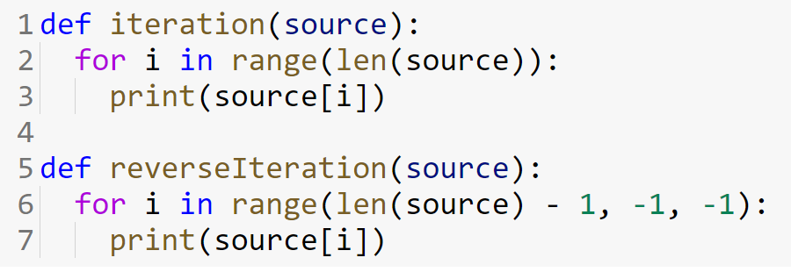
Array - Functions (Iteration)

Slide 23
Array - Functions (Reverse Iteration)

Slide 24
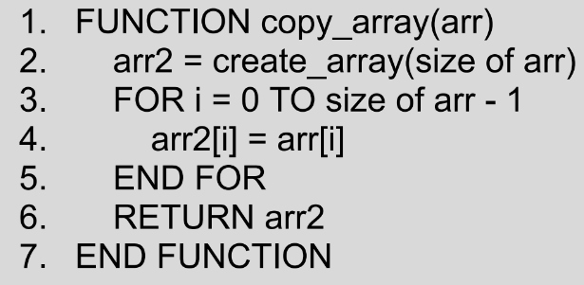
Array - Functions (Copy Array)

Slide 25
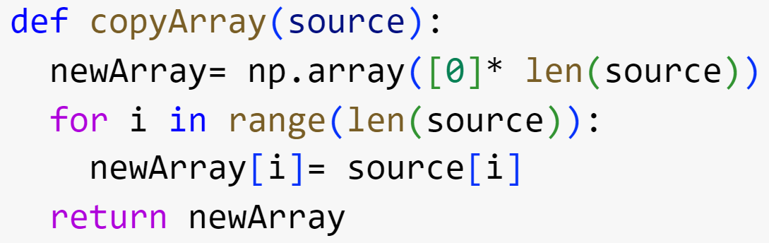
Array - Functions (Copy Array)

Slide 26
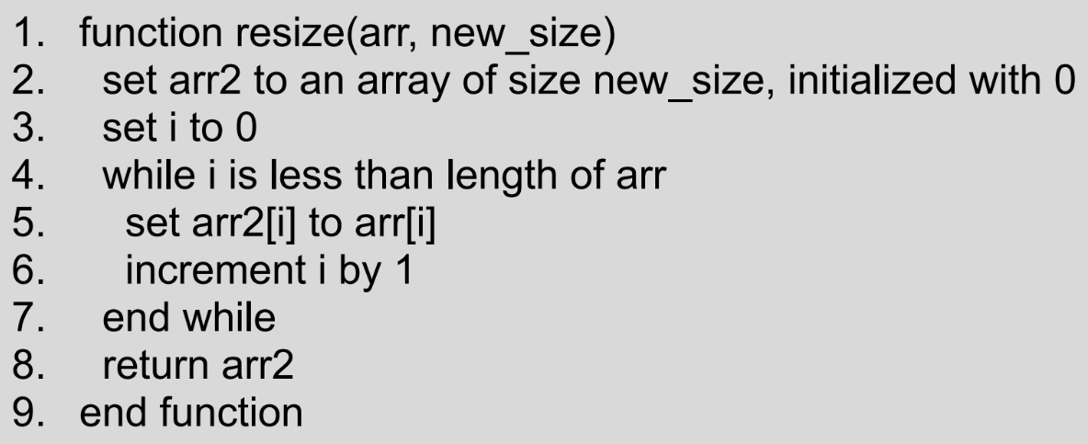
Array - Functions (Resize Array)

Slide 27
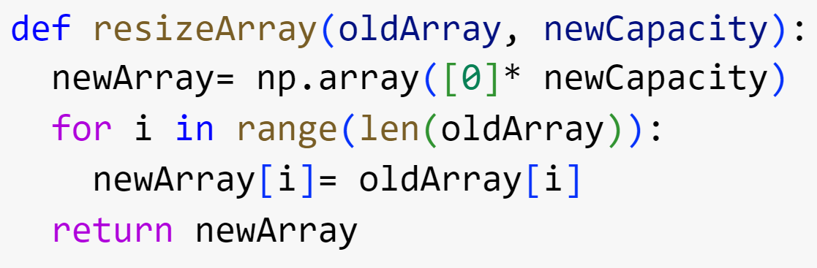
Array - Functions (Resize Array)

Slide 28
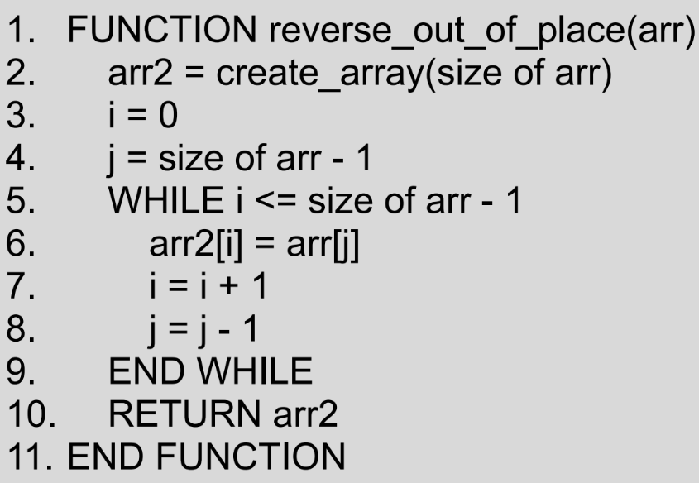
Array - Functions (Reverse Array)

Slide 29
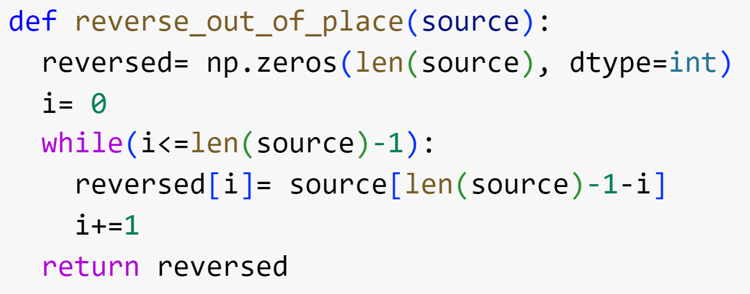
Array - Functions (Reverse Array)

Slide 30
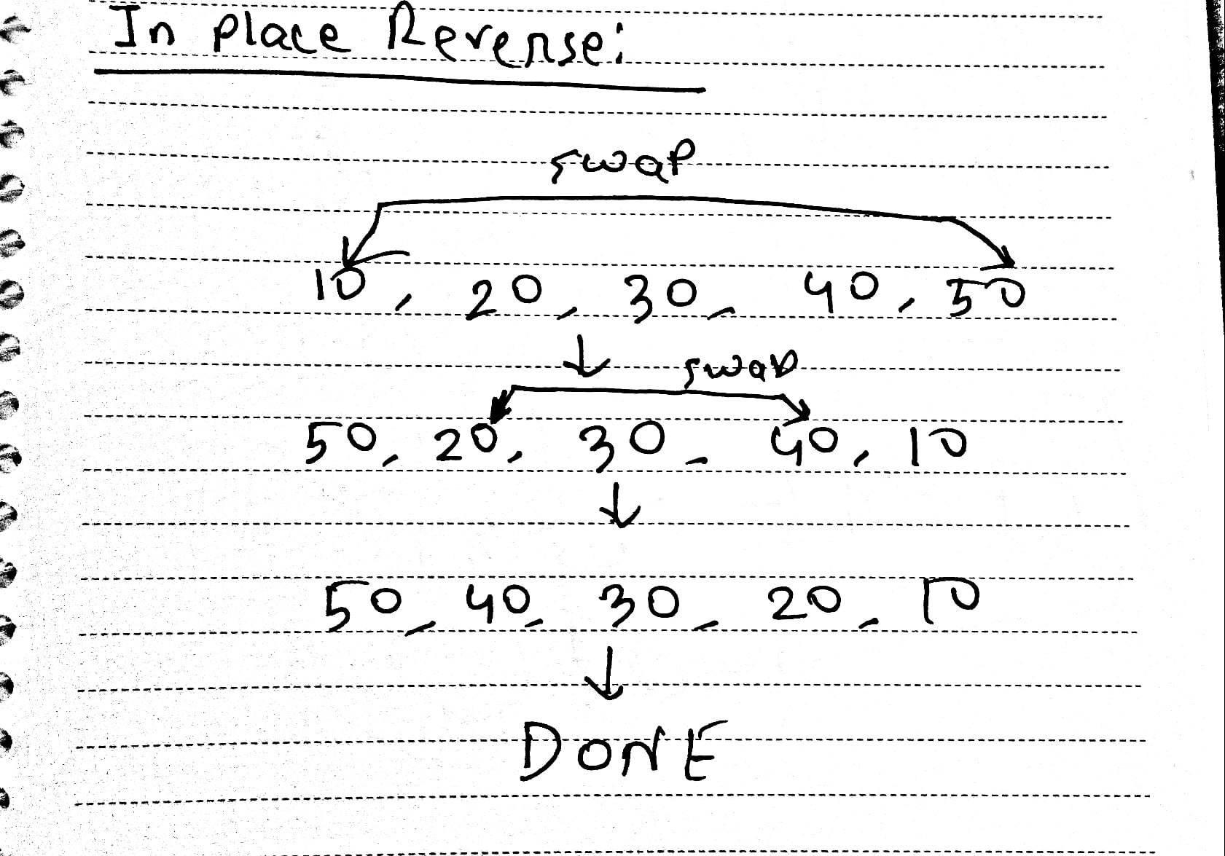
Array - Functions (Reverse Array) (Efficient)

Slide 31
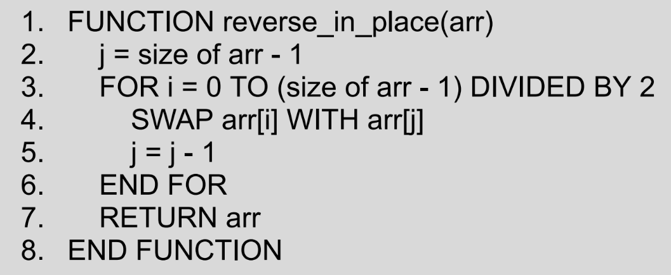
Array - Functions (Reverse Array) (Efficient)

Slide 32
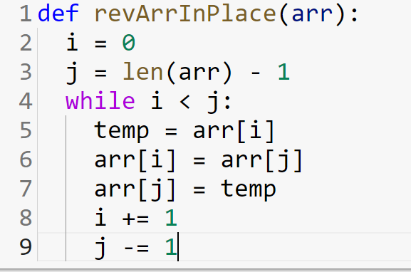
Array - Functions (Reverse Array) (Efficient)

Slide 33
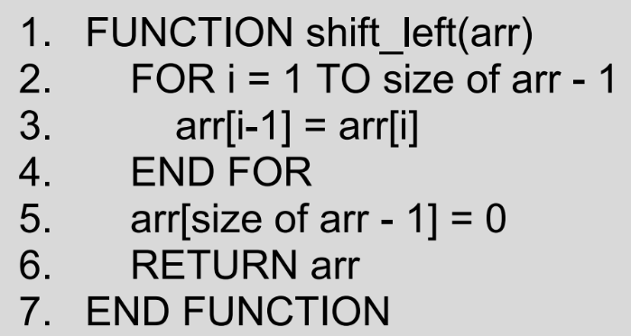
Array - Functions (Shift Left)

Slide 34
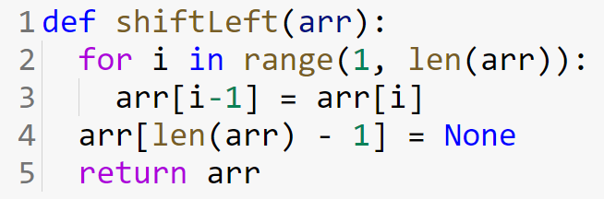
Array - Functions (Shift Left)

Slide 35
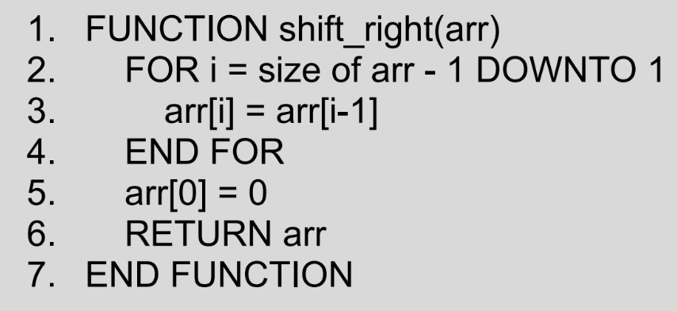
Array - Functions (Shift Right)

Slide 36
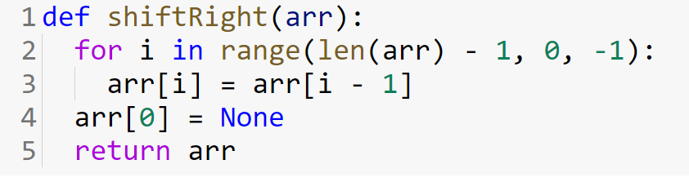
Array - Functions (Shift Right)

Slide 37
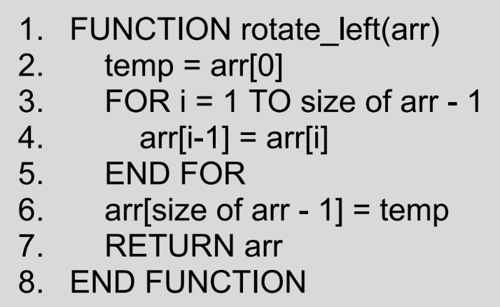
Array - Functions (Rotate Left)

Slide 38
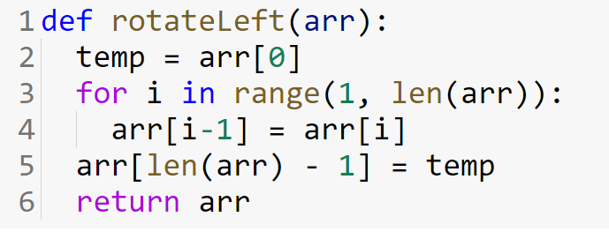
Array - Functions (Rotate Left)

Slide 39
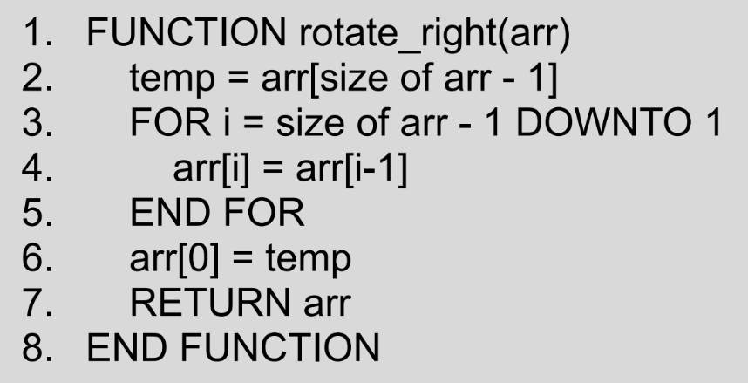
Array - Functions (Rotate Right)

Slide 40
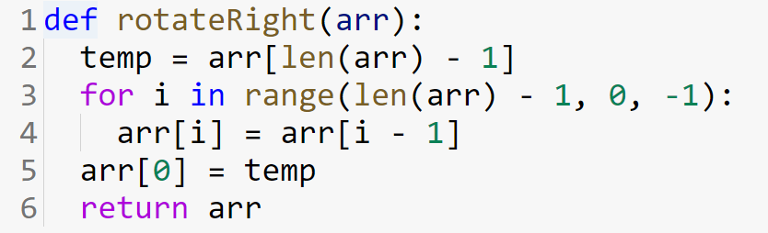
Array - Functions (Rotate Right)

Slide 41
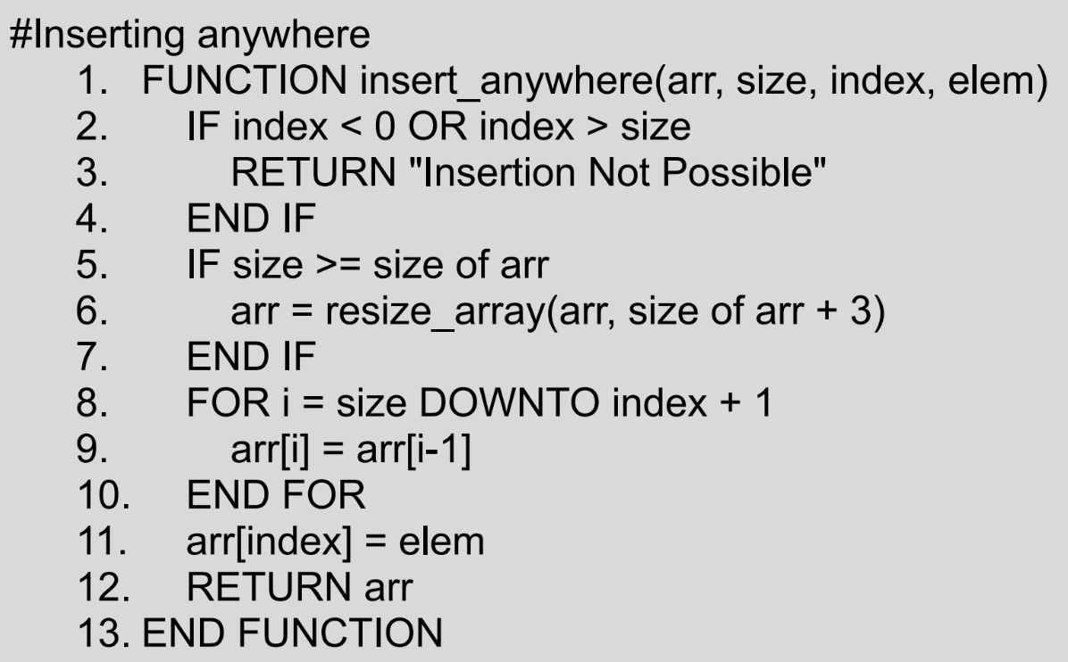
Array - Functions (Insert)

Slide 42
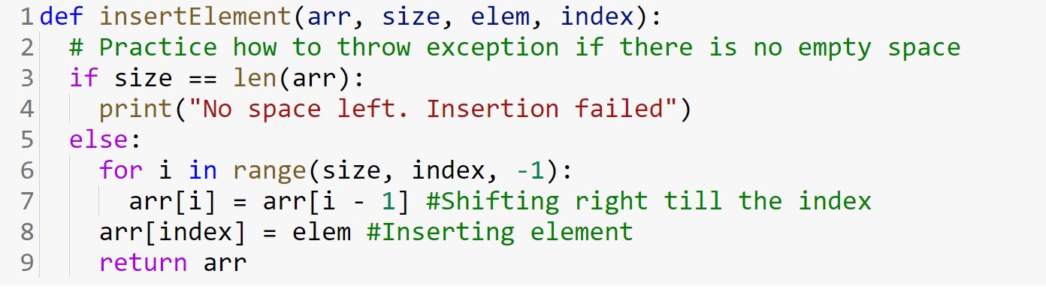
Array - Functions (Insert)

Slide 43
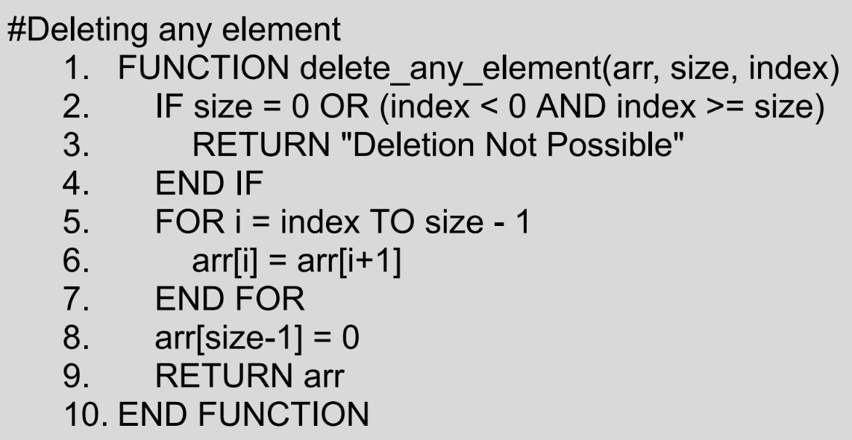
Array - Functions (Remove)

Slide 44
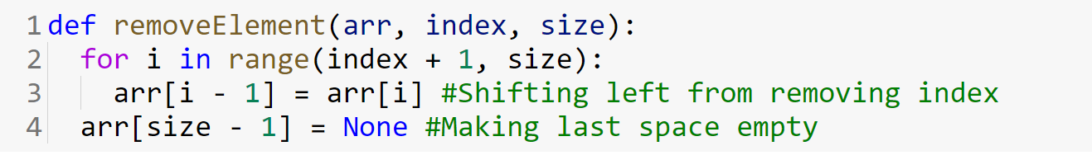
Array - Functions (Remove)

Slide 45
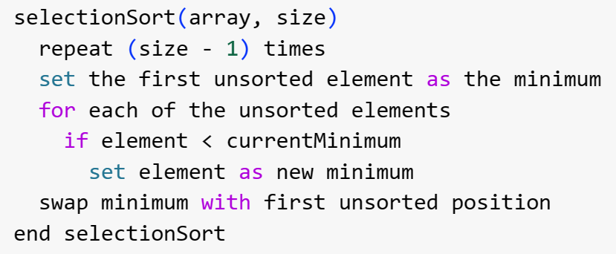
Array - Selection Sort

Slide 46
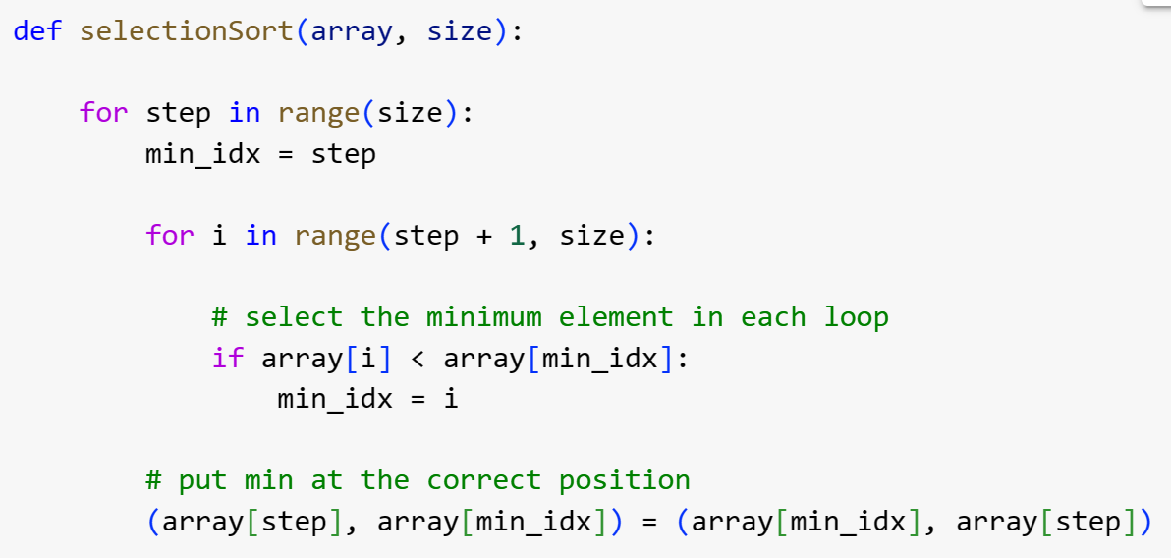
Array - Selection Sort

Slide 47
Array - Bubble Sort
SELF STUDY

Slide 48
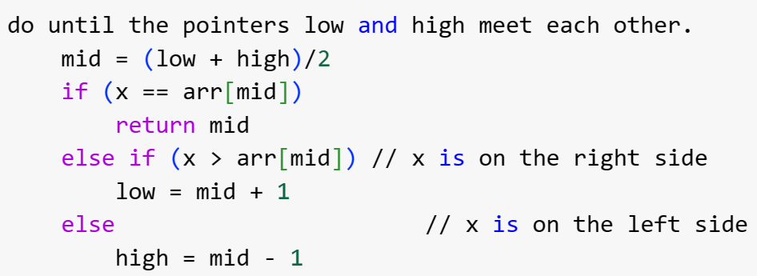
Array - Binary Search

Slide 49
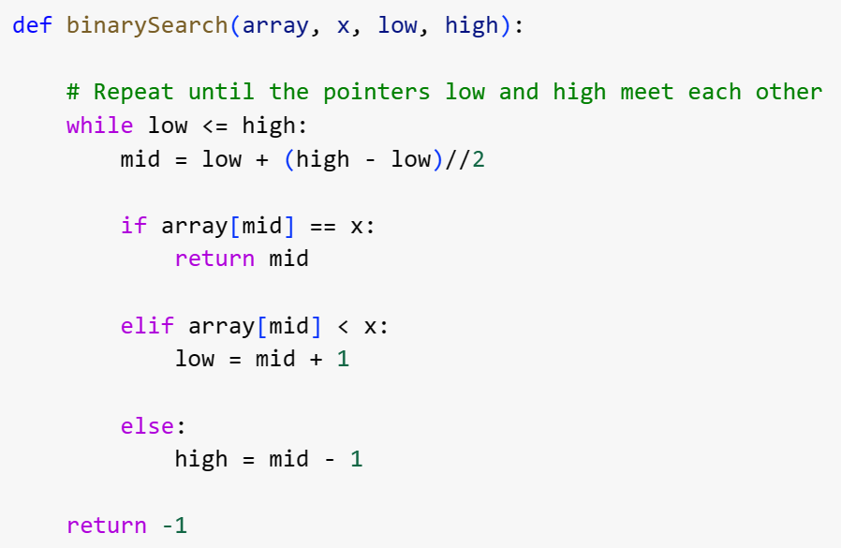
Array - Binary Search

